Slide 1
DevOps AoD CheckRide
2021
Mohd Feroz Baig
Associate Consultant (AWS)

Slide 2
Scenario
Acme Corp has a web application that they’ve containerized but are struggling to push new features reliably, in a timely manner, and at regular ~2 week intervals. Their application engineers coordinate source changes via Github, build image locally, and publish images manually to a private Docker Trusted Registry. Tests are run at the end of each day and a report is emailed to all members of the engineering team. The application runs on a Kubernetes cluster which the team maintains on a set of EC2 servers.
The Leadership of Acme Corp has asked AWS to help them improve their agility, stability, visibility, and scalability through an updated architecture and process. Provide the Acme Leadership team with an architecture diagram of your solution and be prepared to walk them through it.

Slide 3
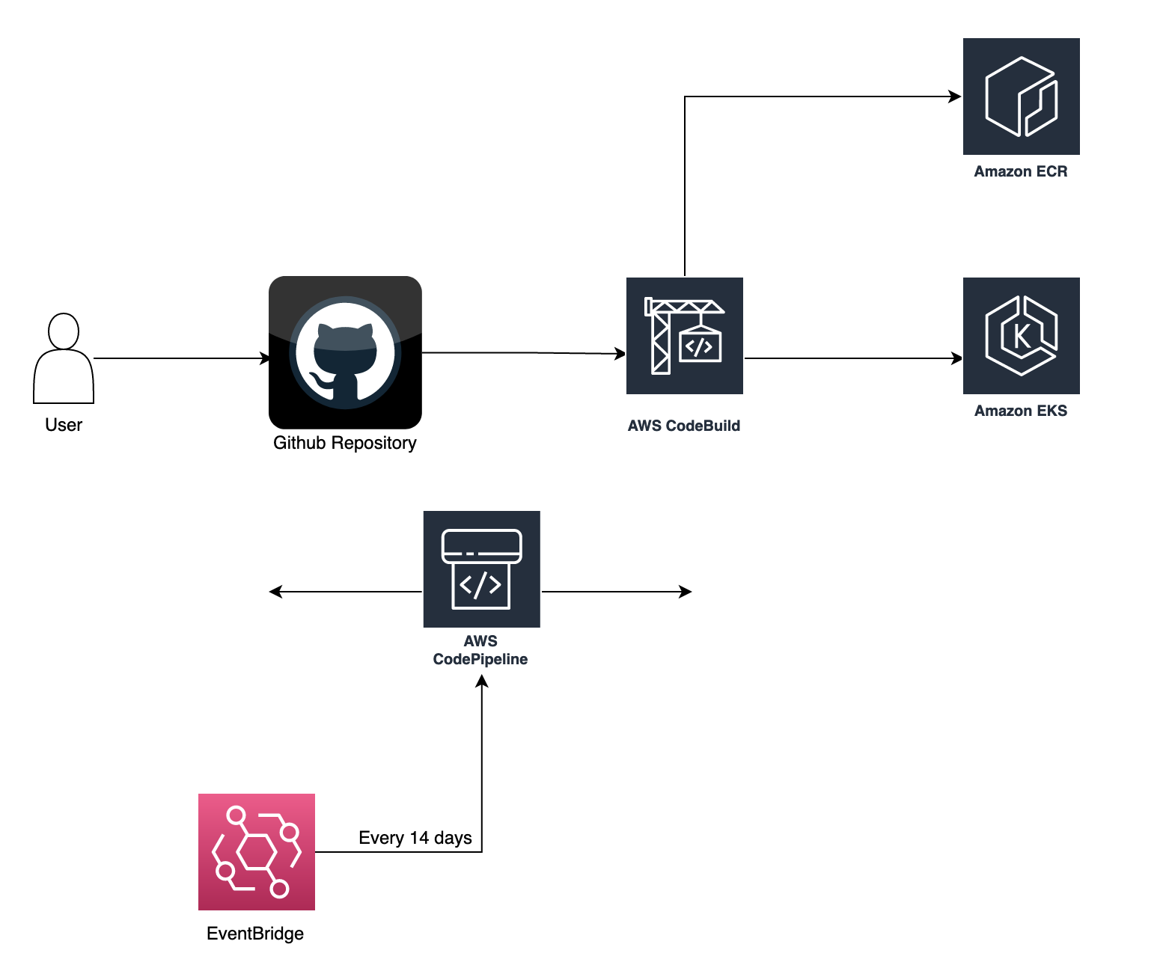
Suggested Architecture
Notes:
AWS CodeBuild is a fully managed continuous integration service that compiles source code, runs tests, and produces software packages that are ready to deploy. With CodeBuild, you don’t need to provision, manage, and scale your own build servers
AWS CodePipeline is a fully managed continuous delivery service that helps you automate your release pipelines for fast and reliable application and infrastructure updates. CodePipeline automates the build, test, and deploy phases of your release process every time there is a code change, based on the release model you define. This enables you to rapidly and reliably deliver features and updates. You can easily integrate AWS CodePipeline with third-party services such as GitHub or with your own custom plugin
Amazon ECR is a fully managed container registry offering high-performance hosting, so you can reliably deploy application images and artifacts anywhere.
Amazon Elastic Kubernetes Service (Amazon EKS) is a managed container service to run and scale Kubernetes applications in the cloud or on-premises.
Amazon EventBridge is a serverless event bus that makes it easier to build event-driven applications at scale using events generated from your applications, integrated Software-as-a-Service (SaaS) applications, and AWS services.

Slide 4
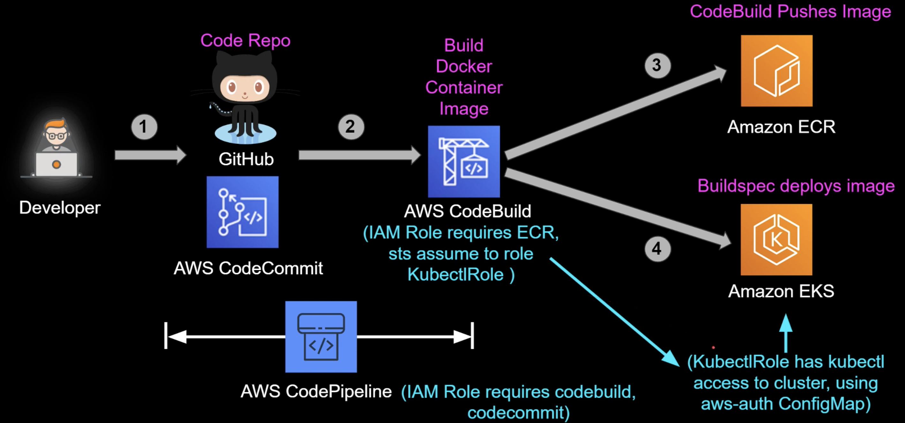
Notes:
Invokes the Kubernetes API to update the image in the Kubernetes application deployment.
ConfigMaps:
- ConfigMaps allow you to decouple configuration artifacts from image content to keep containerized applications portable.
- Applying aws-auth ConfigMap in Amazon EKS (Programmatic Amazon EKS Cluster permission for IAM User/Role)

Slide 5
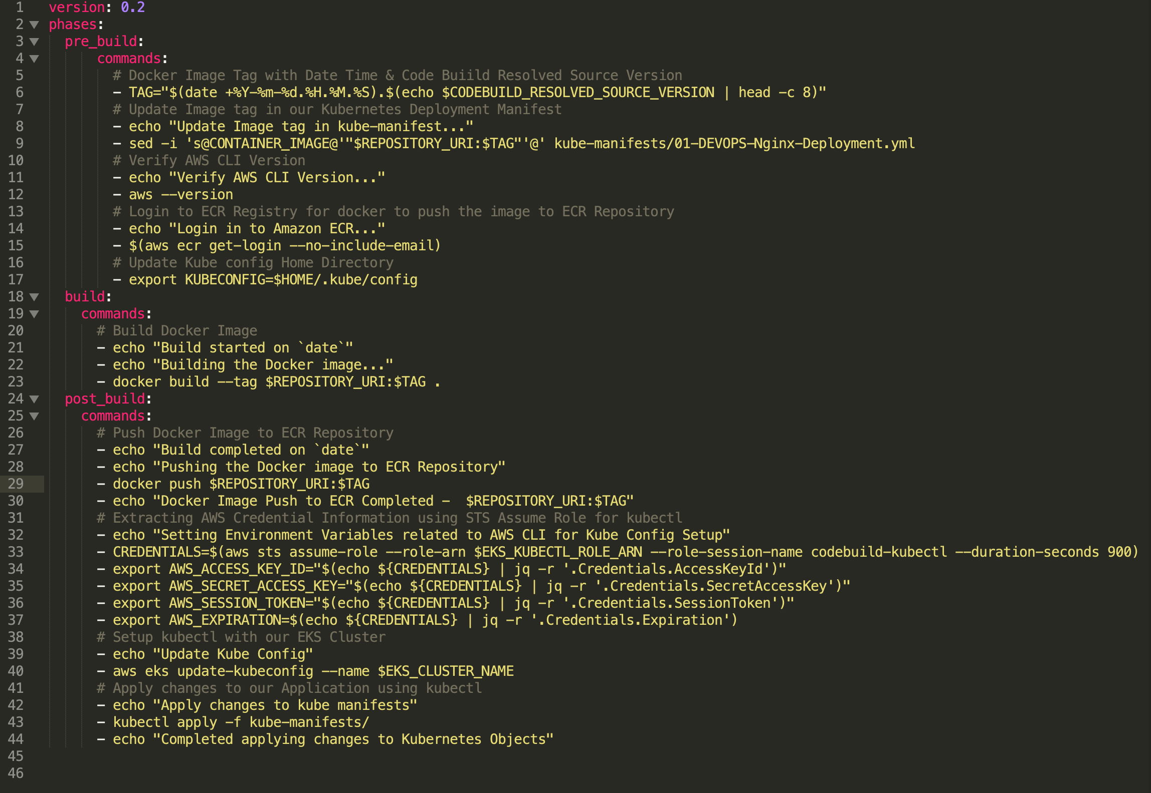
buildspec.yaml

Slide 6
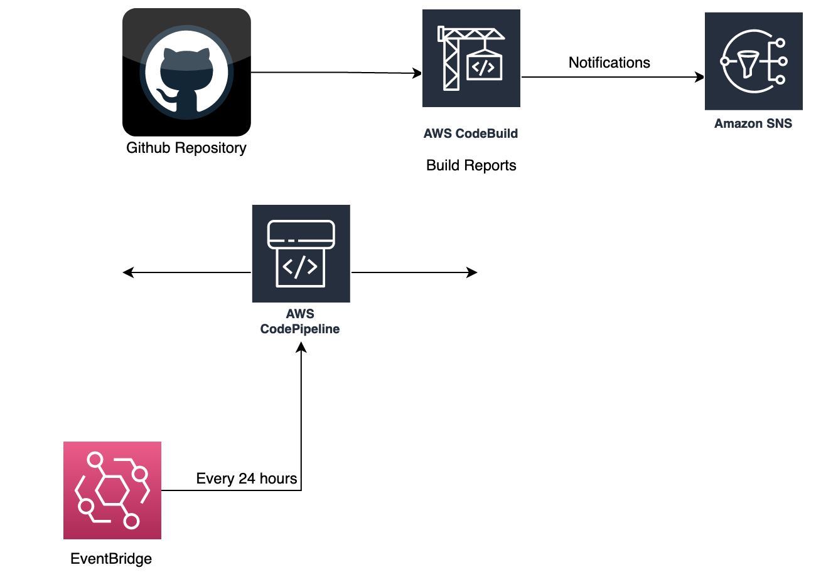
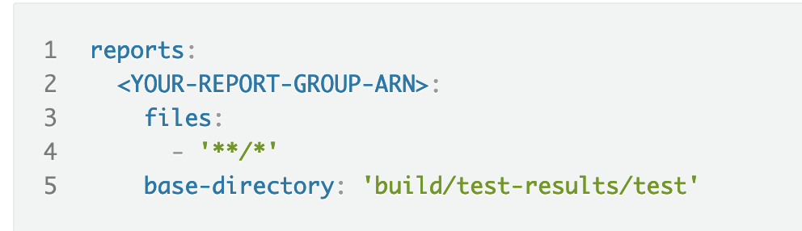
Tests and Reports Generation
buildspec.yaml

Slide 7
Thank You!

